Slide 1
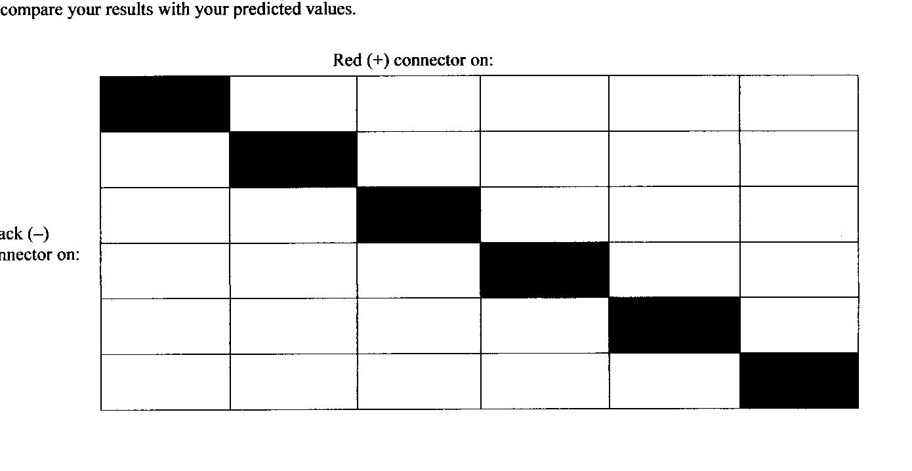
Cu²⁺
Al²⁺
Mg²⁺
Pb²⁺
Zn²⁺
Cu
Al
Mg
Pb
Zn
Copyright © Pearson Education, Inc., or its affiliates. All Rights Reserved.

Slide 2
Electrochemical Processes
Chemical processes can either release energy or absorb energy. The energy can sometimes be in the form of electricity.
An electrochemical process is any conversion between chemical energy and electrical energy.
Copyright © Pearson Education, Inc., or its affiliates. All Rights Reserved.

Slide 3
Electrochemical Processes
What type of chemical reaction is involved in all electrochemical processes?
All electrochemical processes involve redox reactions.

Slide 4
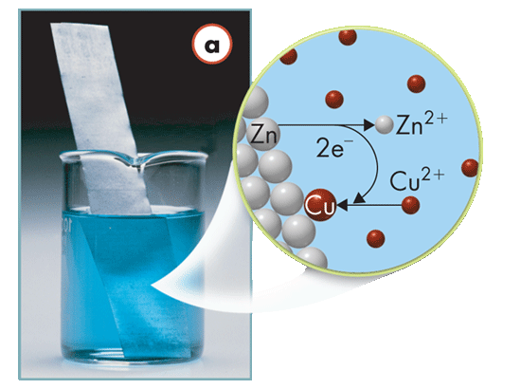
Electrochemical Processes
When a zinc strip is dipped into a copper(II) sulfate solution, electrons are transferred from zinc atoms to copper ions.
This flow of electrons is an electric current.
Copyright © Pearson Education, Inc., or its affiliates. All Rights Reserved.

Slide 5
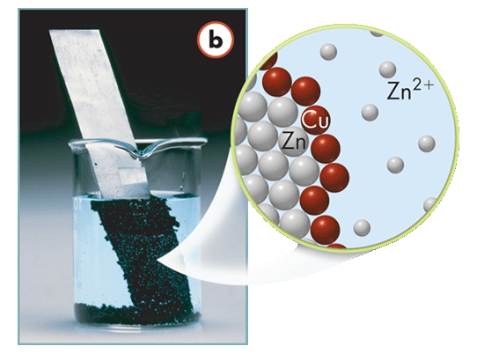
Electrons are transferred from zinc atoms to copper atoms.
Zn(s) + Cu²⁺(aq) → Zn²⁺(aq) + Cu(s)
Copyright © Pearson Education, Inc., or its affiliates. All Rights Reserved.

Slide 6
The net ionic equation involves only zinc and copper.
Zn(s) + Cu²⁺(aq) → Zn²⁺(aq) + Cu(s)
Zinc metal oxidizes spontaneously in a copper-ion solution.
Oxidation: Zn(s) → Zn²⁺(aq) + 2e
Reduction: Cu²⁺(aq) + 2e– → Cu(s)

Slide 7
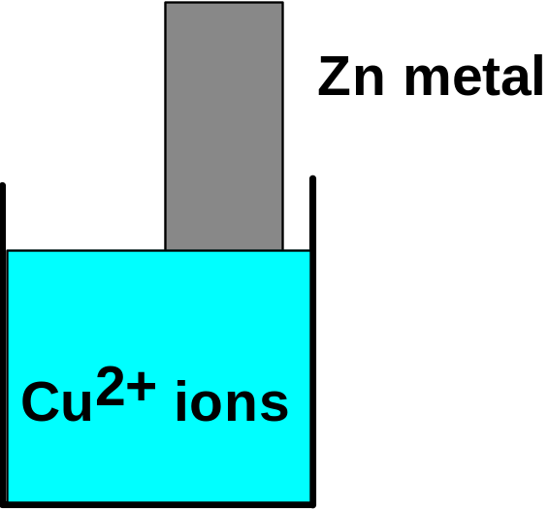
CHEMICAL CHANGE ELECTRIC CURRENT
With time, Cu plates out onto Zn metal strip, and Zn strip“ disappears.”
Zn is oxidized and is the reducing agent
Zn(s) ---> Zn²⁺(aq) + 2e-
Cu²⁺ is reduced and is the oxidizing agent
Cu²⁺(aq) + 2e- ---> Cu(s)

Slide 8
Electrochemical Processes
Activity Series of Metals
 | Element | Oxidation half-reactions
Most active and most easily oxidized | Lithium | Li(s) → Li⁺(aq) + e–
 | Barium | Ba(s) → Ba²⁺(aq) + 2e–
 | Calcium | Ca(s) → Ca²⁺(aq) + 2e–
 | Aluminum | Al(s) → Al³⁺(aq) + 3e–
 | Zinc | Zn(s) → Zn²⁺(aq) + 2e–
 | Iron | Fe(s) → Fe²⁺(aq) + 2e–
 | Nickel | Ni(s) → Ni²⁺(aq) + 2e–
 | Tin | Sn(s) → Sn²⁺(aq) + 2e–
 | Lead | Pb(s) → Pb²⁺(aq) + 2e–
 | Hydrogen* | H₂(g) → 2H⁺(aq) + 2e–
Least easily oxidized | Copper | Cu(s) → Cu²⁺(aq) + 2e–
 | Silver | Ag(s) → Ag⁺(aq) + e–
 | Mercury | Hg(s) → Hg²⁺(aq) + 2e–
For any two metals in an activity series, the more active metal is the more readily oxidized.
Decreasing activity
* Hydrogen is included for reference purposes.

Slide 9
Electrochemical Processes
Zinc is above copper on the list.
Activity Series of Metals
 | Element | Oxidation half-reactions
Most active and most easily oxidized | Lithium | Li(s) → Li⁺(aq) + e–
 | Barium | Ba(s) → Ba²⁺(aq) + 2e–
 | Calcium | Ca(s) → Ca²⁺(aq) + 2e–
 | Aluminum | Al(s) → Al³⁺(aq) + 3e–
 | Zinc | Zn(s) → Zn²⁺(aq) + 2e–
 | Iron | Fe(s) → Fe²⁺(aq) + 2e–
 | Nickel | Ni(s) → Ni²⁺(aq) + 2e–
 | Tin | Sn(s) → Sn²⁺(aq) + 2e–
 | Lead | Pb(s) → Pb²⁺(aq) + 2e–
 | Hydrogen* | H₂(g) → 2H⁺(aq) + 2e–
Least easily oxidized | Copper | Cu(s) → Cu²⁺(aq) + 2e–
 | Silver | Ag(s) → Ag⁺(aq) + e–
 | Mercury | Hg(s) → Hg²⁺(aq) + 2e–
Zinc is more readily oxidized than copper.
When zinc is dipped into a copper(II) sulfate solution, zinc becomes plated with copper.
Decreasing activity
* Hydrogen is included for reference purposes.
Copyright © Pearson Education, Inc., or its affiliates. All Rights Reserved.

Slide 10
Electrochemical Processes
When a copper strip is dipped into a solution of zinc sulfate, the copper does not spontaneously become plated with zinc.
Activity Series of Metals
 | Element | Oxidation half-reactions
Most active and most easily oxidized | Lithium | Li(s) → Li⁺(aq) + e–
 | Barium | Ba(s) → Ba²⁺(aq) + 2e–
 | Calcium | Ca(s) → Ca²⁺(aq) + 2e–
 | Aluminum | Al(s) → Al³⁺(aq) + 3e–
 | Zinc | Zn(s) → Zn²⁺(aq) + 2e–
 | Iron | Fe(s) → Fe²⁺(aq) + 2e–
 | Nickel | Ni(s) → Ni²⁺(aq) + 2e–
 | Tin | Sn(s) → Sn²⁺(aq) + 2e–
 | Lead | Pb(s) → Pb²⁺(aq) + 2e–
 | Hydrogen* | H₂(g) → 2H⁺(aq) + 2e–
Least easily oxidized | Copper | Cu(s) → Cu²⁺(aq) + 2e–
 | Silver | Ag(s) → Ag⁺(aq) + e–
 | Mercury | Hg(s) → Hg²⁺(aq) + 2e–
This is because copper metal is not oxidized by zinc ions.
Decreasing activity
* Hydrogen is included for reference purposes.

Slide 11
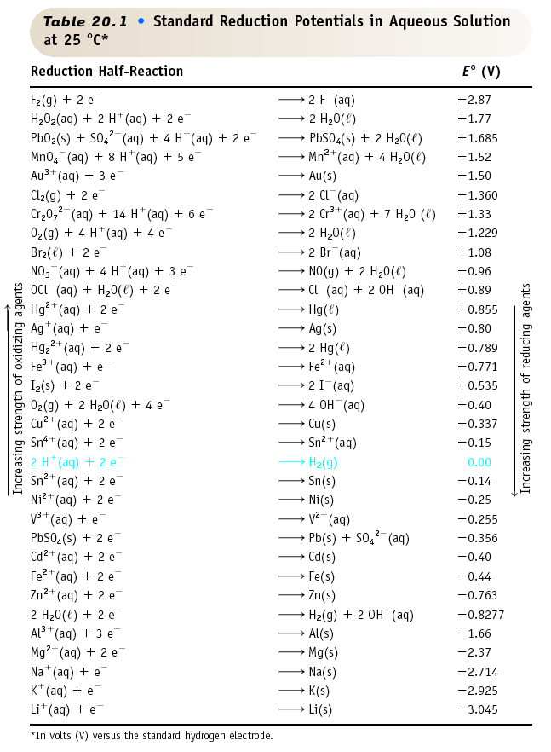
AP SHEET
Reduction Half-
Reactions

Slide 12
Check point
Zn is above Pb in the activity series of metals. Which of the following statements is correct?
A. Zn will react with Pb²⁺.
A. Zn will react with Pb²⁺.
B. Pb²⁺ will react with Zn²⁺.
C. Zn²⁺ will react with Pb.
D. Pb will react with Zn²⁺.

Slide 13
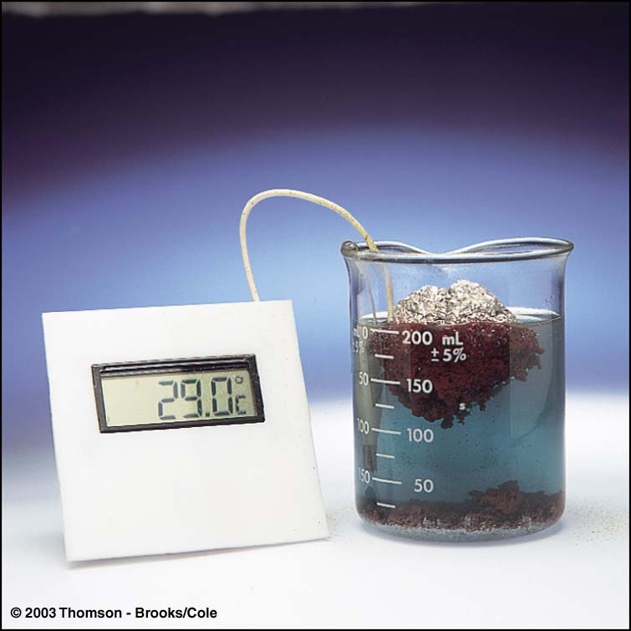
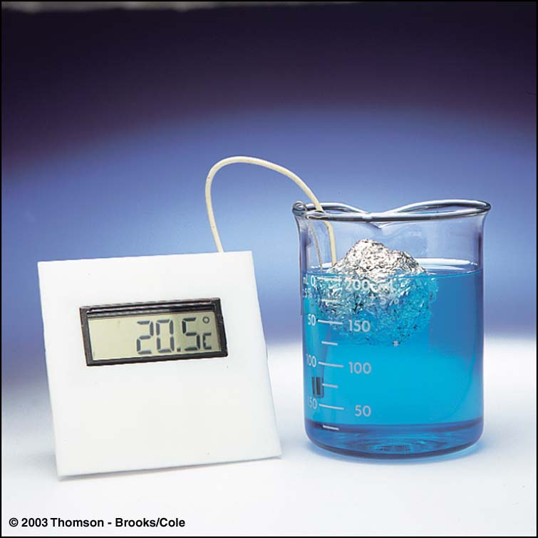
Electrochemical Reactions
Electrons are transferred from Al to Cu²⁺, but there is no useful electric current. Energy released as HEAT.

Slide 14
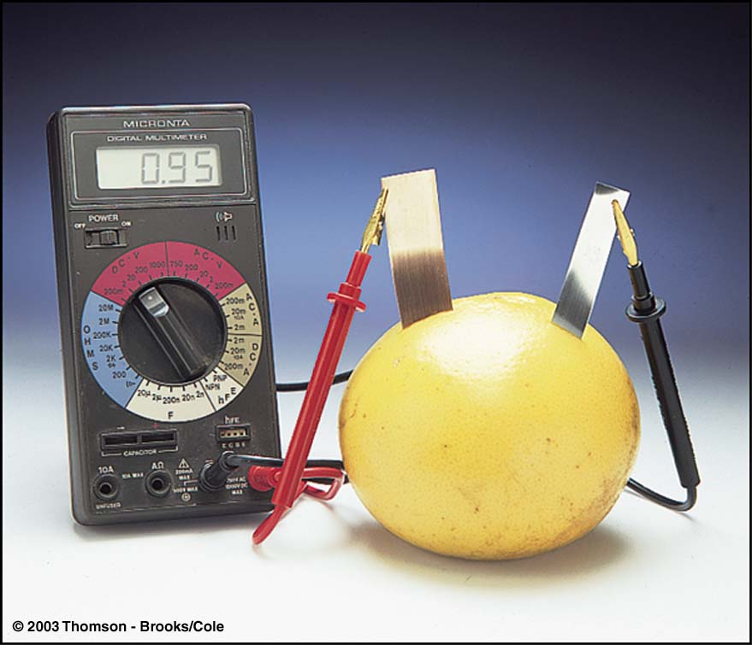
If Al and Cu are separated an electric current is generated and work is done by the electrons. Voltmeter is used to measure the energy .

Slide 15
Voltaic Cells
Voltaic Cells
How does a voltaic cell produce electrical ENERGY?
A voltaic cell is an electrochemical cell used to convert chemical energy into electrical energy.

Slide 16
Voltaic Cells
A voltaic cell consists of two half-cells.
A half-cell is one part of a voltaic cell in which either oxidation or reduction occurs.
A typical half-cell consists of a piece of metal immersed in a solution of its ions.

Slide 17
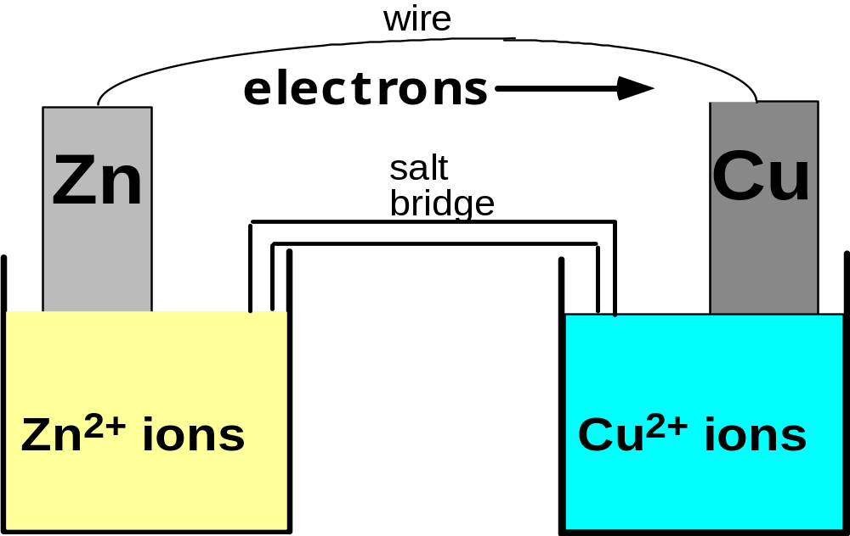
ELECTRIC CURRENT
To obtain a useful current, we separate the oxidizing and reducing agents so that electron transfer occurs thru an external wire.
This is accomplished in a GALVANIC or VOLTAIC cell.
A group of such cells is called a battery.

Slide 18
Basic Concepts of Electrochemical Cells
Anode
Cathode

Slide 19
Constructing a Voltaic Cell
An electrode is a conductor in a circuit that carries electrons to or from a substance other than a metal.
The electrode at which oxidation occurs is called the anode.
Electrons are produced at the anode: out
The anode is labeled the negative electrode in a voltaic cell.

Slide 20
Constructing a Voltaic Cell
The electrode at which reduction occurs is called the cathode.
Electrons are consumed at the cathode: reactant
The cathode is labeled the positive + electrode in a voltaic cell.

Slide 21
Anode, site of oxidation,
negative
Cathode, site of reduction, positive

Slide 22
Zn --> Zn²⁺ + 2e-
Cu²⁺ + 2e- --> Cu
Oxidation
Anode
Negative
Reduction
Cathode
Positive
<--Anions
Cations-->
•Electrons travel thru external wire.
Salt bridge allows anions and cations to move between electrode compartments.

Slide 23
Voltaic Cells
The salt bridge or porous plate allows ions to pass from one half-cell to the other but prevents the solutions from mixing completely.
The half-cells are connected by a salt bridge, which is a tube containing a strong electrolyte, often potassium sulfate (K₂SO₄).
A porous plate may be used instead of a salt bridge.
Copyright © Pearson Education, Inc., or its affiliates. All Rights Reserved.

Slide 24
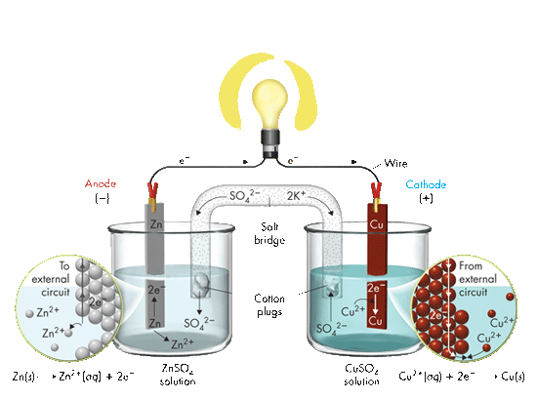
A Voltaic Cell
e–
e–
Wire
Anode
(–)
Cathode
(+)
Salt bridge
Cotton plugs
Zn(s) Zn²⁺(aq) + 2e–
ZnSO₄ solution
CuSO₂ solution
Cu²⁺(aq) + 2e– Cu(s)
In this voltaic cell, the electrons generated from the oxidation of Zn to Zn²⁺ flow through the external circuit (the wire) into the copper strip.
Copyright © Pearson Education, Inc., or its affiliates. All Rights Reserved.

Slide 25
Voltaic Cells
Constructing a Voltaic Cell
The zinc and copper strips in this voltaic cell serve as the electrodes.
e–
e–
Wire
Anode
(–)
Cathode
(+)
Salt bridge
Cotton plugs
Zn(s) Zn²⁺(aq) + 2e–
ZnSO₄ solution
CuSO₂ solution
Cu²⁺(aq) + 2e– Cu(s)
Copyright © Pearson Education, Inc., or its affiliates. All Rights Reserved.

Slide 26
Voltaic Cells
How a Voltaic Cell Works
Step 1
e–
e–
Wire
Anode
(–)
Cathode
(+)
Salt bridge
Cotton plugs
Zn(s) Zn²⁺(aq) + 2e–
ZnSO₄ solution
CuSO₂ solution
Cu²⁺(aq) + 2e– Cu(s)
Electrons are produced at the zinc strip according to the oxidation half-reaction:
Zn(s) → Zn²⁺(aq) + 2e–
Copyright © Pearson Education, Inc., or its affiliates. All Rights Reserved.

Slide 27
Voltaic Cells
How a Voltaic Cell Works
Step 2
If a lightbulb is in the circuit, the electron flow will cause it to light.
e–
e–
Wire
Anode
(–)
Cathode
(+)
Salt bridge
Cotton plugs
Zn(s) Zn²⁺(aq) + 2e–
ZnSO₄ solution
CuSO₂ solution
Cu²⁺(aq) + 2e– Cu(s)
The electrons leave the zinc anode and pass through the external circuit to the copper strip.
Copyright © Pearson Education, Inc., or its affiliates. All Rights Reserved.

Slide 28
Voltaic Cells
How a Voltaic Cell Works
Step 3
e–
e–
Wire
Anode
(–)
Cathode
(+)
Salt bridge
Cotton plugs
Zn(s) Zn²⁺(aq) + 2e–
ZnSO₄ solution
CuSO₂ solution
Cu²⁺(aq) + 2e– Cu(s)
Electrons interact with copper ions in solution. There, the following reduction half-reaction occurs:
Cu²⁺(aq) + 2e– → Cu(s)
Copyright © Pearson Education, Inc., or its affiliates. All Rights Reserved.

Slide 29
Voltaic Cells
How a Voltaic Cell Works
Step 4
e–
e–
Wire
Anode
(–)
Cathode
(+)
Salt bridge
Cotton plugs
Zn(s) Zn²⁺(aq) + 2e–
ZnSO₄ solution
CuSO₂ solution
Cu²⁺(aq) + 2e– Cu(s)
To complete the circuit, both positive and negative ions move through the aqueous solutions via the salt bridge.
Copyright © Pearson Education, Inc., or its affiliates. All Rights Reserved.

Slide 30
How a Voltaic Cell Works
The two half-reactions can be summed to show the overall reaction.
Note that the electrons must cancel.
Zn(s) → Zn²⁺(aq) + 2e–
Cu²⁺(aq) + 2e– → Cu(s)
Zn(s) + Cu²⁺(aq) → Zn²⁺(aq) + Cu(s)
Copyright © Pearson Education, Inc., or its affiliates. All Rights Reserved.

Slide 31
Representing Electrochemical Cells
You can represent the zinc-copper voltaic cell by using the following shorthand form.
Zn(s) ZnSO₄(aq) CuSO₄(aq) Cu(s)
The half-cell that undergoes oxidation (the anode) is written first, to the left of the double vertical lines.
The single vertical lines indicate boundaries of phases that are in contact.
The double vertical lines represent the salt bridge or porous partition that separates the anode compartment from the cathode compartment.

Slide 32
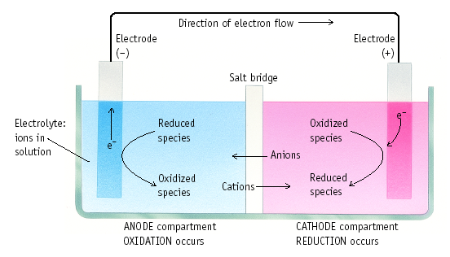
Terms Used for Voltaic Cells
Figure 20.3

Slide 33
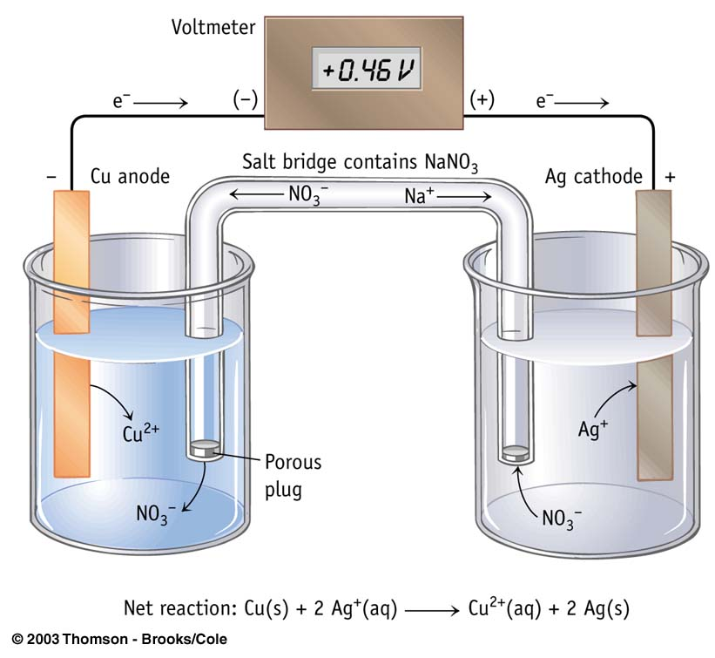
The Cu|Cu²⁺ and Ag|Ag⁺ Cell

Slide 34
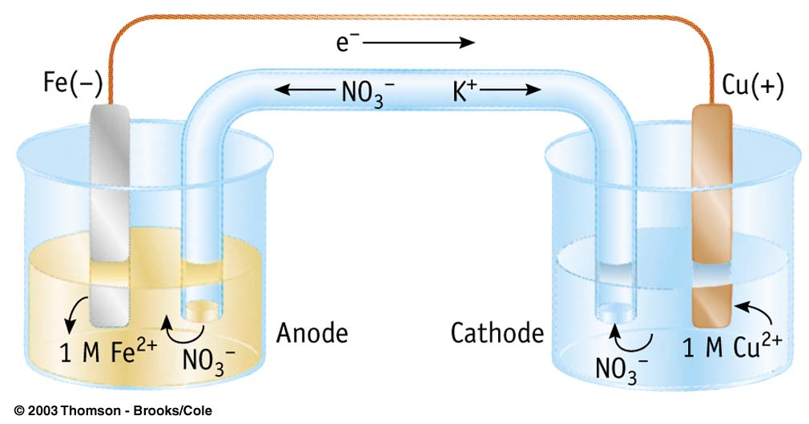

Slide 35
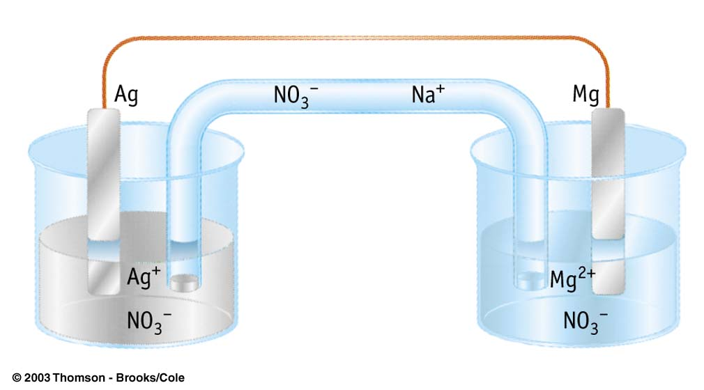
CATHODE
ANODE
Mg(s) → Mg²⁺(aq) + 2e–
2Ag¹⁺(aq) + 2e– → 2Ag(s)
Mg(s) + 2Ag⁺(aq) → Mg²⁺(aq) + 2Ag(s)

Slide 36

A voltaic cell is formed from a piece of iron in a solution of Fe(NO₃)₂ and silver in a solution of AgNO₃. Which is the cathode, and which is the anode? Why?
Copyright © Pearson Education, Inc., or its affiliates. All Rights Reserved.

Slide 37
A voltaic cell is formed from a piece of iron in a solution of Fe(NO₃)₂ and silver in a solution of AgNO₃. What is the cathode half-reaction? and the anode? Cell notation?
Fe(s) Fe(NO₃) ₂₍aq) AgNO₃(aq) Ag(s)
Fe(s) → Fe²⁺(aq) + 2e–
2Ag¹⁺(aq) + 2e– → 2Ag(s)
Fe(s) + 2Ag⁺(aq) → Fe²⁺(aq) +2 Ag(s)
Copyright © Pearson Education, Inc., or its affiliates. All Rights Reserved.

Slide 38
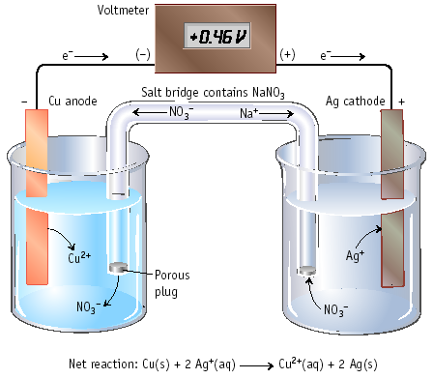
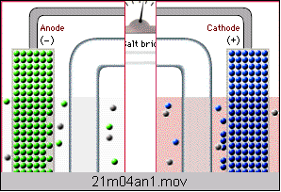
Electrochemical Cell
Electrons move from anode to cathode in the wire.
Anions & cations move thru the salt bridge.

Slide 39
Current Applications
Electrochemical processes produce electrical energy in dry cells, lead storage batteries, and fuel cells.
A dry cell is a voltaic cell in which the electrolyte is a paste.
A battery is a group of voltaic cells connected together.
Fuel cells are voltaic cells in which a fuel undergoes oxidation and from which electrical energy is continuously obtained.
Copyright © Pearson Education, Inc., or its affiliates. All Rights Reserved.

Slide 40
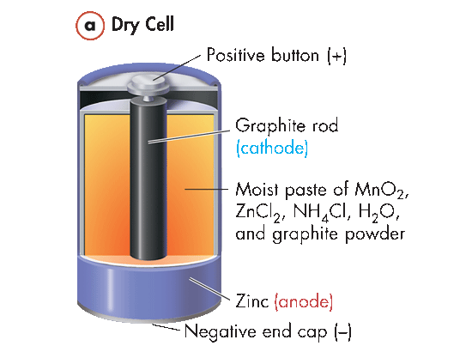
Dry Cells
In one type of dry cell, a zinc container is filled with a thick, moist electrolyte paste of manganese(IV) oxide (MnO₂), zinc chloride (ZnCl₂), ammonium chloride (NH₄Cl), and water (H₂O).
Positive button (+)
A graphite rod is embedded in
the paste.
The zinc container is the anode, and the graphite rod is the cathode.
The thick paste and its surrounding paper liner prevent the contents of the cell from freely mixing, so a salt bridge is not needed.
Graphite rod (cathode)
Moist paste of MnO₂, ZnCl₂, NH₄Cl₂, H₂O, and graphite powder
Zinc (anode)
Negative end cap (–)
Copyright © Pearson Education, Inc., or its affiliates. All Rights Reserved.

Slide 41
Dry Cells
Oxidation: Zn(s) → Zn²⁺(aq) + 2e– (at anode)
Reduction: 2MnO₂(s) + 2NH₄⁺(aq) + 2e– →
Mn₂O₃(s) + 2NH₃(aq) + H₂O(l) (at cathode)
Positive button (+)
Dry cells of this type are not rechargeable because the cathode reaction is not reversible.
Graphite rod (cathode)
Moist paste of MnO₂, ZnCl₂, NH₄Cl₂, H₂O, and graphite powder
Zinc (anode)
Negative end cap (–)
Copyright © Pearson Education, Inc., or its affiliates. All Rights Reserved.

Slide 42
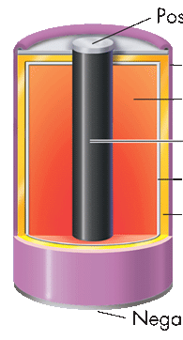
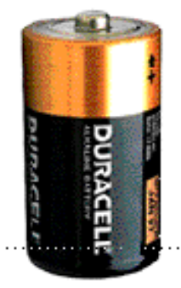
Alkaline Battery
Positive button (+)
Steel case
MnO₂ in KOH paste
Nearly same reactions as in common dry cell, but under basic conditions.
Graphite rod (cathode)
Absorbent separator
Zinc (anode)
Negative end cap (–)
Anode (-): Zn + 2 OH⁻ ---> ZnO + H₂O + 2e-
Cathode (+): 2 MnO₂ + H₂O + 2e- --->
Mn₂O₃ + 2 OH⁻

Slide 43
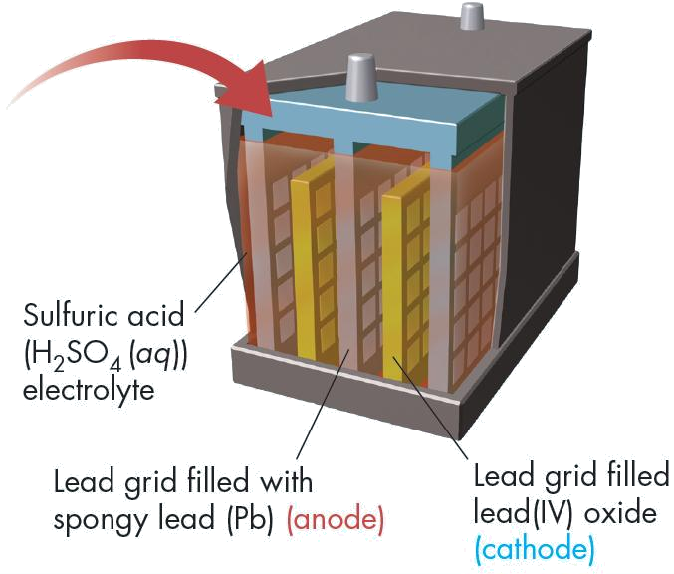
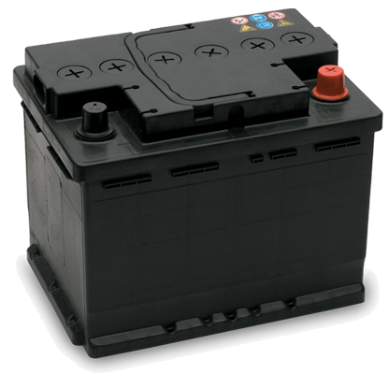
Lead storage batteries
A battery is a group of voltaic cells connected together.
A 12-V car battery consists of six voltaic cells connected together.
Copyright © Pearson Education, Inc., or its affiliates. All Rights Reserved.

Slide 44
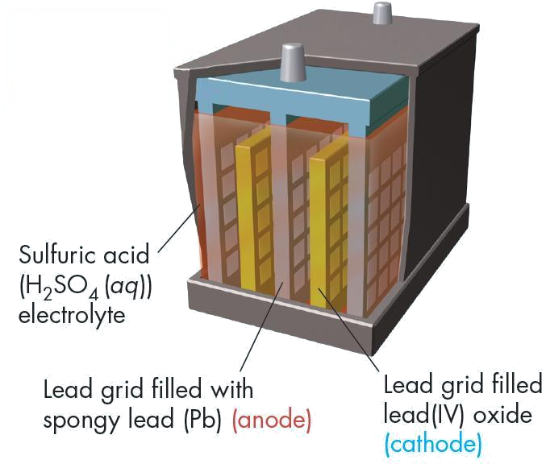
Lead Storage Batteries
The half-reactions are as follows:
Oxidation:
Pb(s) + SO₄^{2–}(aq) → PbSO₄(s) + 2e–
Reduction:
PbO₂(s) + 4H⁺(aq) + SO₄^{2–}(aq) + 2e– →
PbSO₄(s) + 2H₂O(l)
Copyright © Pearson Education, Inc., or its affiliates. All Rights Reserved.

Slide 45
Lead Storage Batteries
The overall spontaneous redox reaction that occurs is the sum of the oxidation and reduction half-reactions.
Pb + PbO₂ + 2H₂SO₄(aq) → 2PbSO₄ + 2H₂O
Lead(II) sulfate forms during discharge.The sulfate slowly builds up on the plates, and the concentration of the sulfuric acid electrolyte decreases.
Copyright © Pearson Education, Inc., or its affiliates. All Rights Reserved.

Slide 46
Lead Storage Batteries
The reverse reaction occurs when a battery is recharged.
2PbSO₄+ 2H₂O → Pb + PbO₂ + 2H₂SO₄(aq)
This is not a spontaneous reaction.
To make this reaction proceed, a direct current must be applied and pass through the cell
Copyright © Pearson Education, Inc., or its affiliates. All Rights Reserved.

Slide 47
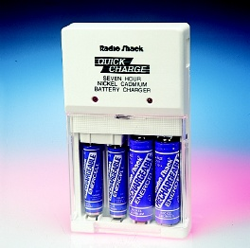
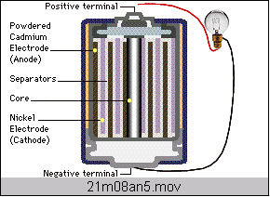
Ni-Cad Battery
Anode (-)
Cd + 2 OH⁻ ---> Cd(OH)₂ + 2e-
Cathode (+)
NiO(OH) + H₂O + e- ---> Ni(OH)₂ + OH⁻

Slide 48
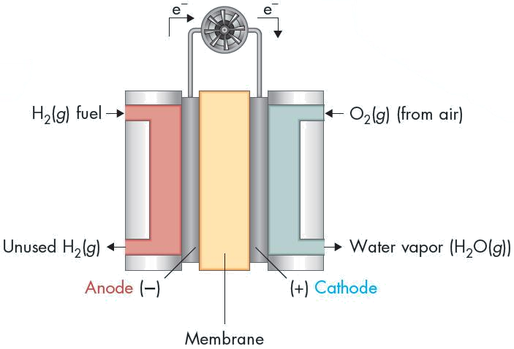
Fuel Cells
The hydrogen-oxygen fuel cell is a clean source of power.
The only product of the reaction is liquid water.
Such cells can be used to fuel vehicles.
Copyright © Pearson Education, Inc., or its affiliates. All Rights Reserved.

Slide 49
FUEL CELLS
The half-reactions are as follows:
Oxidation: 2H₂(g) → 4H⁺(aq) + 4e– (at anode)
Reduction: O₂(g) + 4H⁺(aq) + 4e– → 2H₂O(g)
(at cathode)
The overall reaction is the oxidation of hydrogen (fuel) to form water.
2H₂(g) + O₂(g) → 2H₂O(g)
Copyright © Pearson Education, Inc., or its affiliates. All Rights Reserved.

Slide 50
Fuel Cells
Fuel cells are voltaic cells in which a fuel substance undergoes oxidation and from which electrical energy is continuously obtained.
They can be designed to emit no air pollutants and to operate more quietly and more cost-effectively than a conventional electrical generator.
Copyright © Pearson Education, Inc., or its affiliates. All Rights Reserved.

